Slide 1
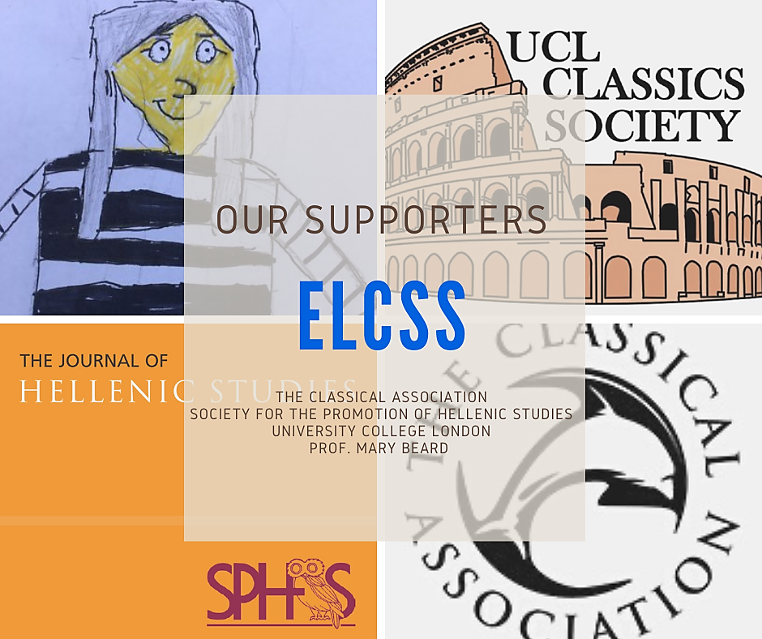

East London Classics Summer School
Yr10 GCSE Latin Language Course | 5-Days
Mon 27 July - Fri 31 July 2026 (£250)
Hackney, East London
Course Outcomes
By the end of the week, you will:
  understand key grammatical and syntactical structures that will appear in GCSE Latin language exam.
  recognise these constructions even when they appear in unfamiliar “unseen” passages.
  translate more confidently and accurately.
  feel more secure in your Latin reading skills, boosting both your exam performance and your appreciation of the classical world.
  ELCSS Summer School 2025 – student feedback
I thought the quality of teaching, the lessons and the overall experience was very excellent. I enjoyed it!
Thank you for the lessons.
This was so amazing and thank you so much.
In hindsight it’s a very riveting experience and it helps deepen your knowledge.
Thank you so much for this, it’s been an amazing experience!
ELCSS Course Overview
This five-day course is designed for students who have studied Latin for one to three years and are preparing for their GCSE exams in June 2027.
It is especially helpful for anyone who has just finished Yr10 and wants to strengthen their skills in the language component of the course, particularly fine-tuning key vocabulary and grammar.
Taught by expert classics teachers, the sessions focus on making Latin clearer, more manageable, and even enjoyable.
You’ll work through essential grammar and syntax needed for GCSE success by working on your exam technique and completing engaging learning activities.

Slide 2
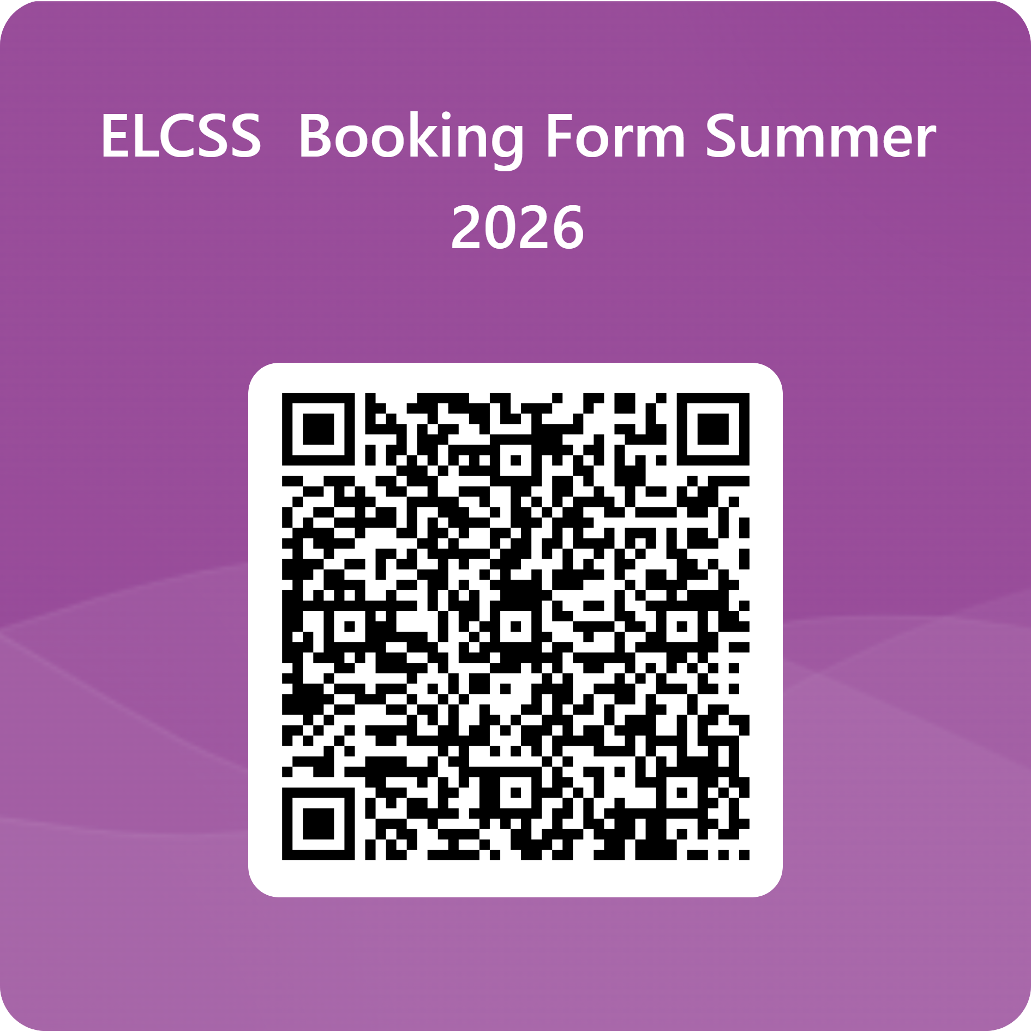

£250 for 5-days (snacks included)
Financial support available due to support of our amazing sponsors – please ask! gratias vobis agimus
eastlondoncss@gmail.com

